Slide 1
Blockchain-Based Land Registration System
CSE7101- Capstone Project
Review-2
Batch Number: 20221CBC(CBC_3)
Under the Supervision of, Dr. Akshatha Y
Dr. Akshatha Y
Assistant Professor
School of Computer Science and Engineering
Presidency University
Roll Number | Student Name
20221CBC0005 | Varsha BR
20221CBC0048 | Sandya KJ
20221CBC0051 | C.Lokesh
Name of the Program: B.Tech
Name of the HoD: Dr. Pravinthraja S
Name of the Program Project Coordinator: Dr. H M Manjula
Name of the School Project Coordinators: Dr. Sampath A K ,Dr Geetha A

Slide 2
Problem Statement Number: PSCS_4
Organization:: Presidency University
Category :SOFTWARE
Problem Description:Current land registration systems are prone to fraud, delays, and lack of transparency.Manual record-keeping leads to disputes and high verification time. Need for a tamper-proof, transparent, and efficient solution.

Slide 3
Content
Problem Statement
Proposed Solution
Objectives
System Architecture
System Requirements
Advantages
Challenges & Solution
Github Link
Conclusion & Future Scope
References

Slide 4
Content (continuation)..
Problem Statement :Current land registration systems are prone to fraud, delays, and lack of transparency. Manual record-keeping leads to disputes and high verification time.Need for a tamper-proof, transparent, and efficient solution.
A solution is needed to:
Blockchain-Based Land Registry
Smart Contracts for Transactions
Decentralized Access & Transparency

Slide 5
Objectives
Objective | Research Gap (till 2025) | Our Feature (Proposed Solution)
1. Legally Enforceable & Verifiable Land Transfers | Most studies proved blockchain feasibility but lacked legal enforceability and mechanisms for court-ordered reversals. | Smart contracts with CourtOrder module allowing authorized legal officers to pause, override, or amend records with audit trails.
2. Trusted Boundaries & Role-Based Access | Previous works assumed survey data correctness but lacked a system for authenticating boundaries and verifying official roles (e.g., surveyors). | Verifiable Credentials (VCs) for all officials; hash-based proofs for cadastral maps/drone-survey files before land transfer.
3. Privacy, Interoperability & Citizen-Centric Design | Most prototypes ignored privacy issues and integration with tax, banking, or court systems; citizen-friendly UIs were largely absent. | Selective disclosure proofs for data privacy, adapters for e-stamp/tax/GIS, and progressive web app with offline/SMS support.

Slide 6
Blockchain-Based Land Registration Research (2022–2025)
Model / Approach | Year | Author(s) / Founder(s) | Publication / Source | Merits | Demerits / Gaps
Securing Land Registration using Blockchain | 2022 | Vaibhav Lagad, Shriyash Parandkar, Mahesh Raut, Akash Sarade, Shilpa Pimpalkar | IJIRSET, Vol 11 Issue 7 (2022) (IJIRSET) | Introduces basic blockchain concept for land registry; initiates security discussion in academic context. | Limited to conceptual scope; lacks implementation detail and legal integration.
A Secure Land Record Management System using Blockchain | 2023 | Md. Samir Shahariar, Pranta Banik, Md. Ahsan Habib | arXiv (2023) (arXiv) | Adds privacy using asymmetric cryptography, digitizes paper-based records, speeds ownership changes by ~33%. | Prototype-level; lacks real-world deployment and infrastructure integration.
Land Registration System Using Blockchain | 2024 | Anujit Nair, Hiten Patel, Vivek Parmar, Shubham Agrawal, Prof. Brijesh Vala | IJIRSET, Vol 13 Issue 3 (March 2024) (IJIRSET) | Permissioned blockchain, smart contracts, digital identity, UI—enhances transparency and automation. | Testnet-only (Ganache); lacks scalability tests and government interoperability.
Blockchain-Based Land Registry | 2025 | Shubham Mishra, Hrithik Kumar, Priya Sharma | IJCRT, Vol 13 Issue 5 (May 2025) (IJCRT) | Comprehensive review: emphasizes transparency, smart contract automation, fraud reduction, building trust. | Highlights legal ambiguity, privacy issues, and scalability concerns; no implementation case study.

Slide 7
System Architecture
Frontend: HTML, CSS, JavaScript (React/Angular optional)
Backend: Node.js / Express
Blockchain: Ethereum (Test net / Private Network)
Database: IPFS + Mongo DBSmart
Contracts: Solidity.

Slide 8
Software Requirements
OS: Windows / Linux / MacOS
Web Browser: Chrome / Firefox
Node.js & NPM
Ganache / Truffle for blockchain development
MetaMask extension

Slide 9
Advantages
High security & transparency.
Reduced fraud & paperwork.
Immutable transaction history.
24/7 accessibility from anywhere.

Slide 10
Challenges & Solutions
Challenge Solution
High gas fees Use private blockchain or Layer-2 solutions
User adoption Provide training and easy-to-use UI
Large file Store only file hashes on blockchain and
Storage actual files in IPFS

Slide 11
Github Link
The Github link provided should have public access permission.
Github Link
https://github.com/Sandyakj48/Capstone_PSCS_611

Slide 12
Conclusion & Future Scope
Can integrate with government databases for real-world adoption.
Potential to expand into multi-country land management systems.
Future integration with AI for fraud detection.

Slide 13
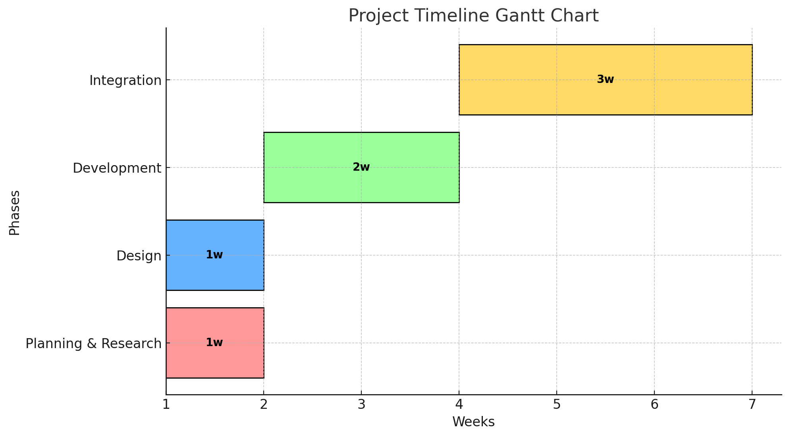
Timeline of the Project

Slide 14
References (IEEE Paper format)
https://tijer.org/JNRID/papers/JNRID2411012.pdf
https://link.springer.com/article/10.1007/s11540-024-09716-1
https://watercalculator.org

Slide 15


